Slide 1

ECE-5831 PATTERN RECOGNITION AND NEURAL NETWORKS Project Presentation Implementing In-Vehicle Security
Professor: Team:
Azeem Hafeez Raj Kumar Edury
Uttej Thandu

Slide 2

Contents
Motivation
Introduction
Feature Set
Methodologies used
K-Nearest Neighbors
Naïve Bayes
Results
Comparison of two methods
Conclusion

Slide 3

Motivation of the Project
Security Vulnerabilities a threat to Automotive Innovation.
Physical and personal data privacy.
Enhancing cybersecurity measures

Slide 4
Introduction
The project aims to:
Implement the personal data privacy to the user
Message authentication received at the ECUs
Data Acquisition
Data is acquired from 8 CAN transceivers.
An Oscilloscope is used to record the voltage samples with sampling rate of 20 Msa/s
Features are extracted from the data and used for model training and evaluation.

Slide 5
cont. Introduction
Dataset description
The dataset is obtained from the data generated by Electronic control units(ECUs)
Dataset consists of data coming from 8 Control Area Networks(CANs)
Each CAN has about 30 samples/files with signal recorded for 599 microseconds.
We extracted features from these 599-microsecond sample.
Dataset size is 8CAN*30files = 240 samples/observations.
We are planning to us 70% of data for training the model and 30% for testing the data.

Slide 6
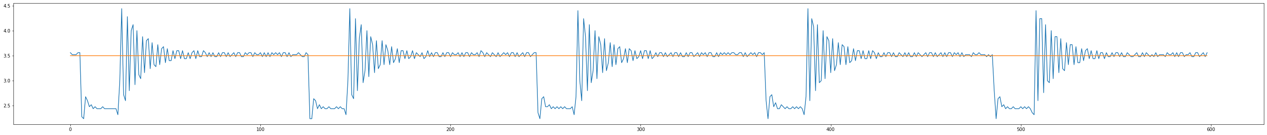
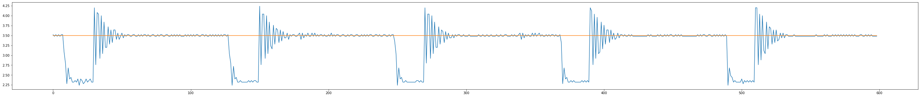
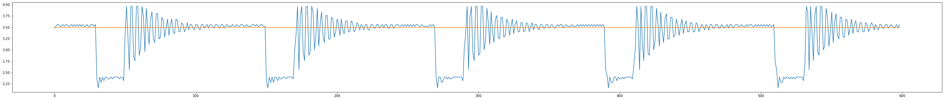
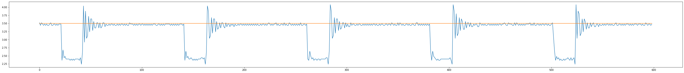
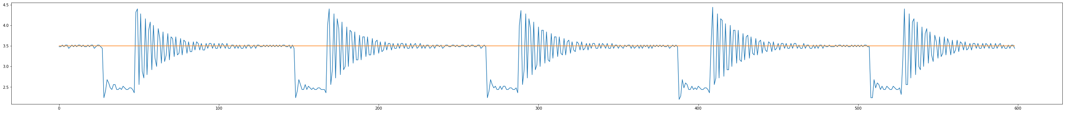
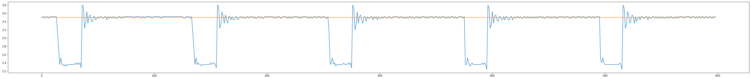
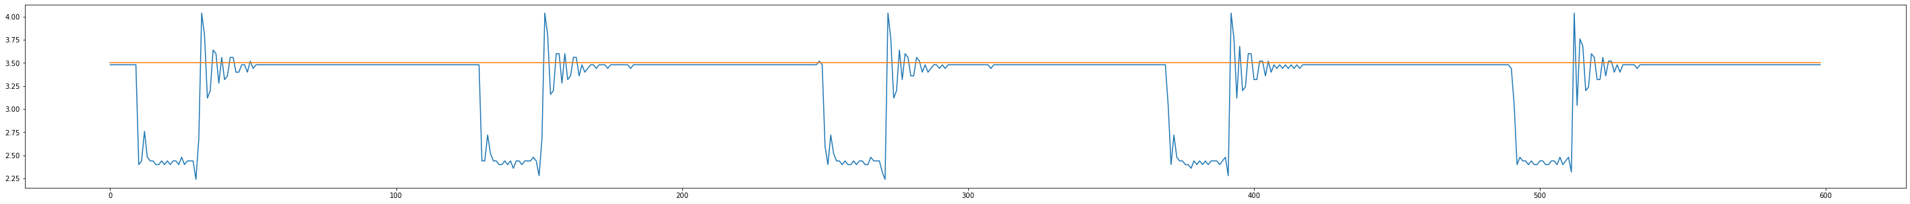
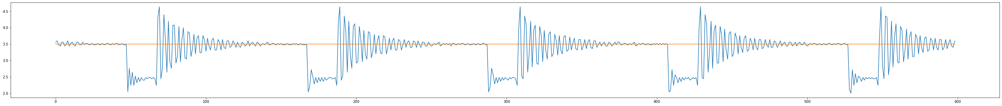
contd.Introduction

Slide 7
Feature Set
Standard Deviation
Mean of Overshoot
Mean of Settling time
Kurtosis
Skewness

Slide 8
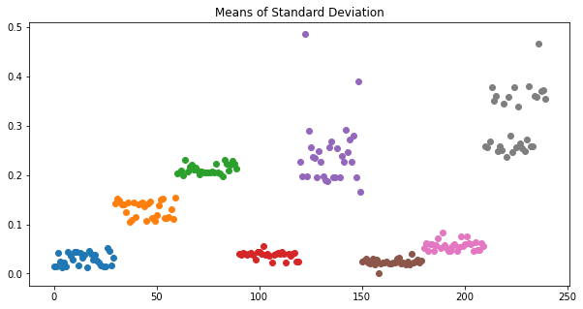
cont. Feature Set
Standard Deviation
Calculated mean of SD for each sample in CAN data and got 1 SD for 599 observations in each file (sample).
Each CAN has 30 samples, so a total of 240 SDs are calculated for 8 CANs.

Slide 9
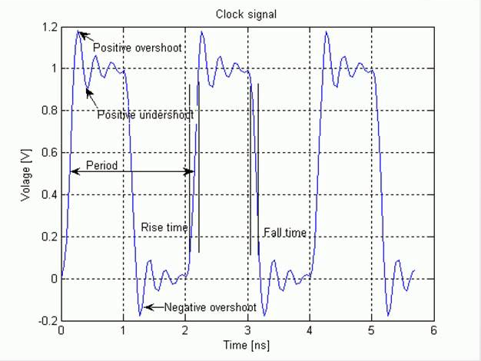
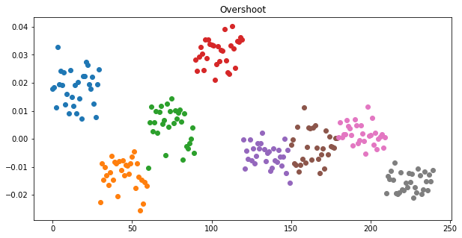
cont. Feature Set
Mean of Overshoot
Overshoot is an occurrence of a signal exceeding its target value.
Calculated a total of 240 means for the 240 files from 8 CANs.
This feature helps better classification among CANs.

Slide 10
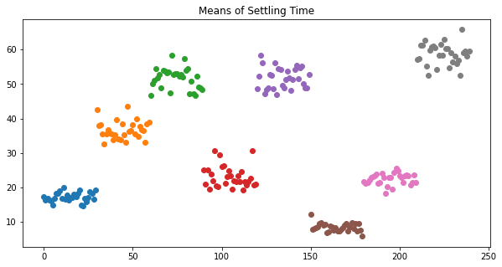
cont. Feature Set
Mean of Settling Time
Settling time is the time taken for a signal to get within a certain range of the ideal value without subsequently deviating from it by a greater amount.
Calculated settling time for all the dominant values in the dataset and calculated their mean.

Slide 11

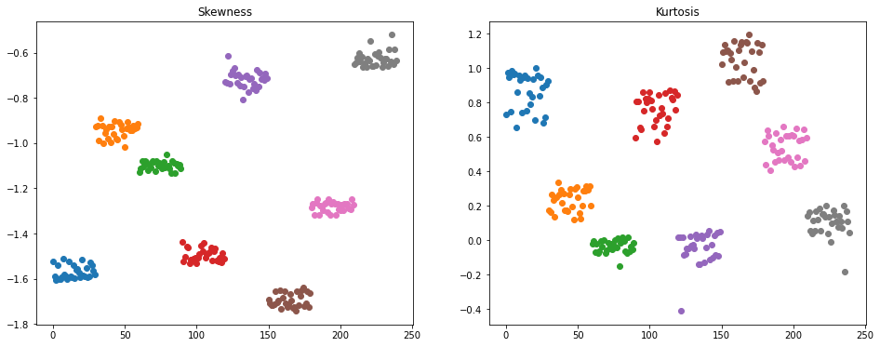
cont. Feature Set
Kurtosis and Skewness
Kurtosis is a measure of whether the data are heavy-tailed or light-tailed relative to a normal distribution.
That is, data sets with high kurtosis tend to have heavy tails, or outliers vice versa.

Slide 12
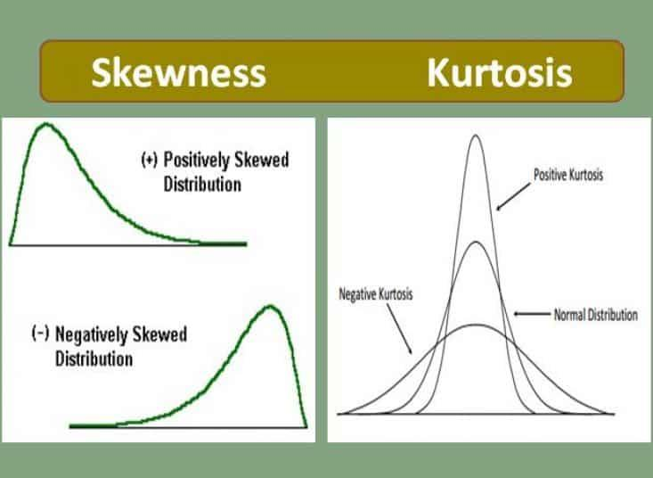

cont. Feature Set
Skewness is a measure of symmetry, or more precisely, the lack of symmetry.
A distribution, or data set, is symmetric if it looks the same to the left and right of the center point.
Both Kurtosis and Skewness adds towards accuracy in
classification of CAN data.

Slide 13
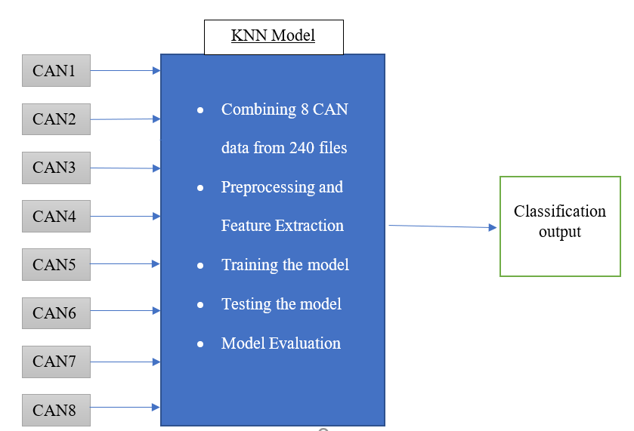
Methodologies Used
K-Nearest Neighbor
K = 4
Weighted distance = 1/(1+d)

Slide 14
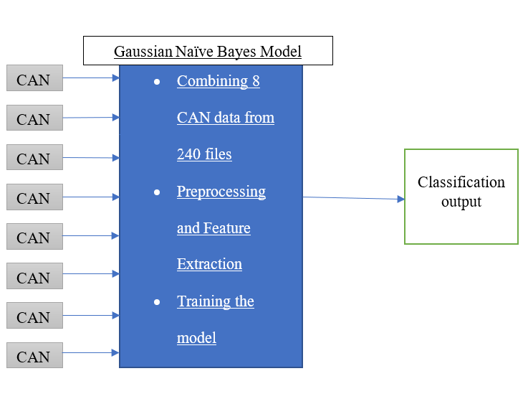
Methodologies Used
Gaussian Naïve Bayes
SVM
Linear kernel

Slide 15
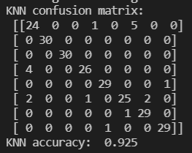
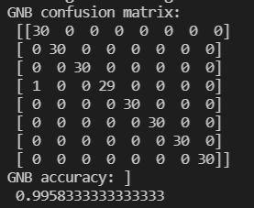
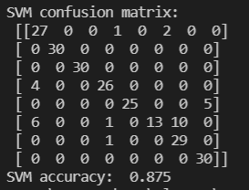
Results
Cross validation
Stratified K fold
K = 5
Training and Test scores
Classifier | Training score | Test score
KNN | 0.969 | 0.925
Gaussian Naïve Bayes | 0.998 | 0.995
SVM | 0.884 | 0.875

Slide 16
Conclusion
It is evident that the all the CANs are not transmitting the same signal, hence, we can classify the signals with the help of these features.
Gaussian Naïve Bayes is clearly the more accurate than the KNN
Adding more data will most definitely increase the accuracy of the models

Slide 17
Thank you!

